Slide 1
GÉANT WiFiMon for Wi-Fi Network Monitoring
Nikos Kostopoulos, NTUA, WiFiMon Team Member
Elisantila Gaci, RASH, WiFiMon Service Manager
Network Performance and Monitoring Workshop
Virtual Event
February 14, 2024

Slide 2
WiFiMon GÉANT Service
Open-source tools for Wi-Fi performance monitoring
Measurements relying on: - Crowdsourcing (software probes): Reports of Wi-Fi performance as experienced by end users - Hardware probes: Reports from devices placed at fixed locations
Richer analysis options (e.g. throughput per Access Point - AP) for IEEE 802.1X networks (eduroam) by incorporating data from RADIUS & DHCP logs
Contributions:
Measurements independent of specific Access Point (AP) vendors
Detection of Wi-Fi throughput degradation
→ Admins may enhance performance, e.g. by installing more APs
Smart distributed control and configuration of hardware probes

Slide 3

WiFiMon vs Related Monitoring Tools
Monitoring from the end-user perspective (end-user experience)
No requirements for app installation or end-user intervention
Flexible control and configuration of hardware probes in a distributed manner

Slide 4
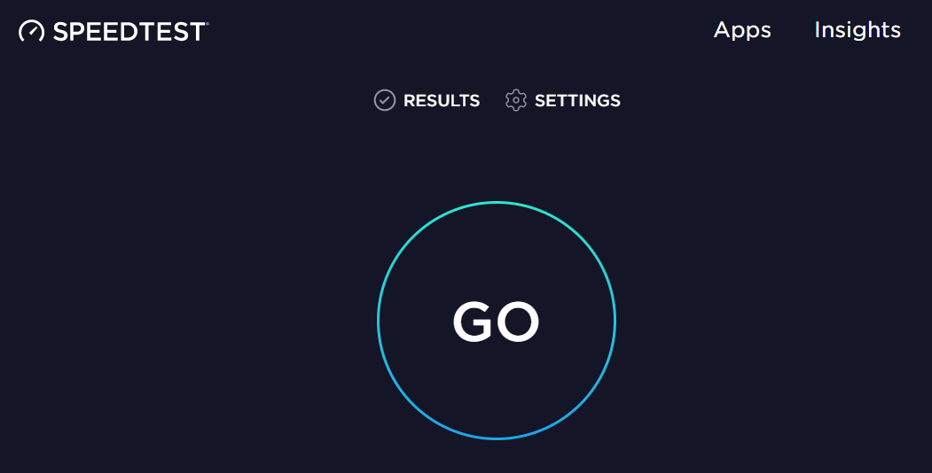
Example: WiFiMon vs Ookla Speedtest
WiFiMon | Ookla Speedtest
Automatically by visiting a site | By pressing “GO”
Wi-Fi administrator | End users
Measurements are triggered:
Results collected by:

Slide 5
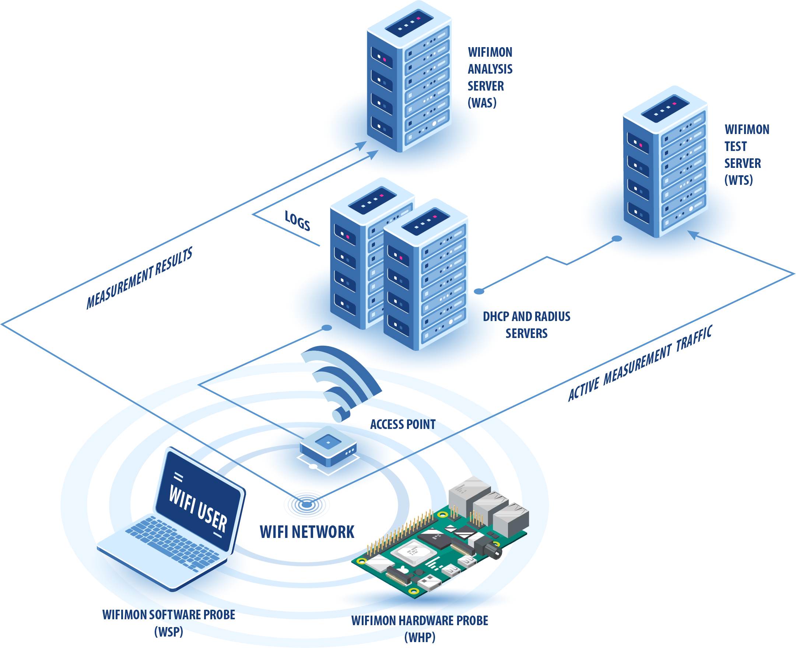
WiFiMon Operation
WiFiMon Components:
WiFiMon Software Probes (WSPs)
WiFiMon Hardware Probes (WHPs)
WiFiMon Analysis Server (WAS)
WiFiMon Test Server (WTS)

Slide 6


WiFiMon Test Server (WTS)
Purpose: Code and test data for performance measurements
Based on JavaScript (JS) technology
HTML script tags pointing to test tools added to frequently visited sites
2 available test tools:
Akamai Boomerang
LibreSpeed Speedtest
WTS Placement: Close to the monitored networks
(RTT between end devices and WTS included in results)
→ If impossible: WiFiMon captures relative performance changes

Slide 7
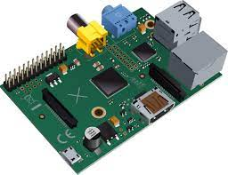
WiFiMon Hardware Probes (WHPs)
Wi-Fi performance measurements from fixed points within the network
Baseline throughput that complements crowdsourced measurements
Performance measurements similar to WSP ones
Additional data about monitored and nearby ESSIDs
TWAMP Measurements, system data (CPU, memory, etc)
Triggering measurements based on crontabs
Tested for Raspberry Pi v3 and v4

Slide 8
WiFiMon Capabilities: Recent Pilot at Yerevan, Armenia

Slide 9
Pilot Details
The 3rd WiFiMon pilot
Monitoring eduroam at the Institute for Informatics and Automation Problems (IIAP) - National Academy of Sciences of Armenia
Pilot duration: September 21st – October 4th 2023
Monitoring about 50-100 people (researchers, professors, engineers, students)
Measurements from 1 WHP (Raspberry Pi 4 Model B)
WAS/WTS installed in a single VM with 4 vCPU’s, 8 GB RAM (WiFiMon v2.1.0)
Pilot Goals:
Experiment with newly introduced WiFiMon features
Help IIAP Wi-Fi administrators identify interesting points that require further inspection

Slide 10
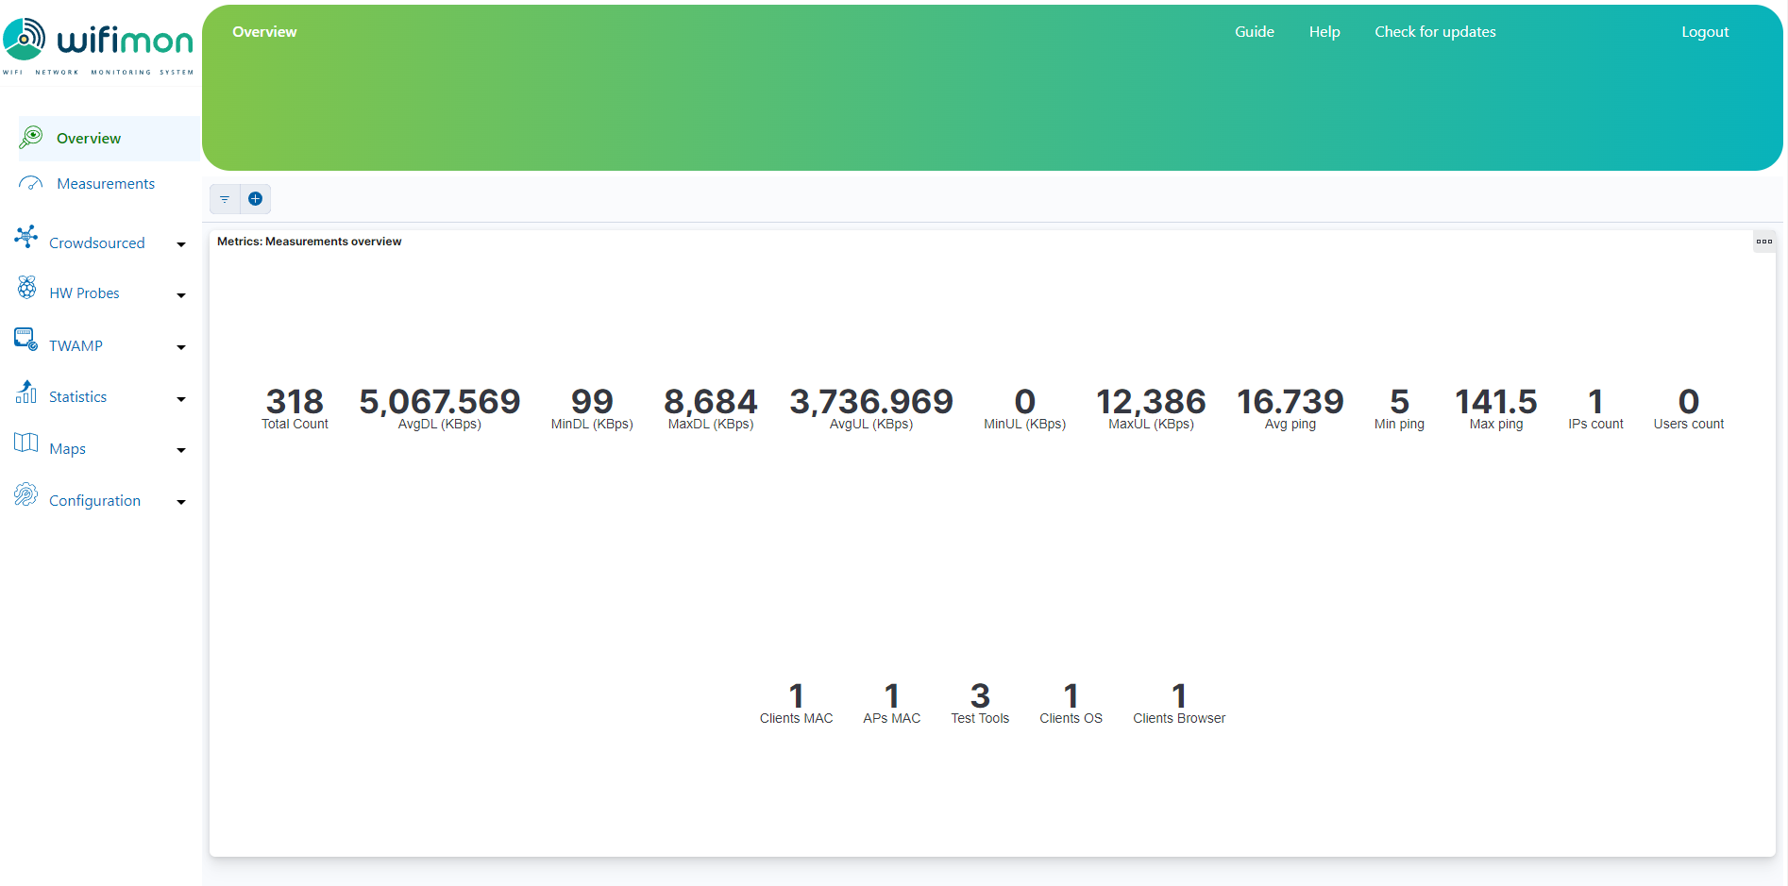
Overview of WiFiMon Measurements
The Overview tab summarizes received measurements on a daily basis

Slide 11
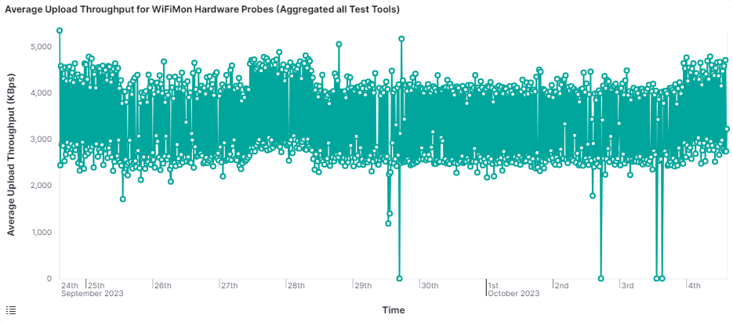
Average Upload Throughput Measurements
The results of all test-tools (Boomerang and LibreSpeed) are aggregated
Significant drops (blue circles) are visible in the chart

Slide 12
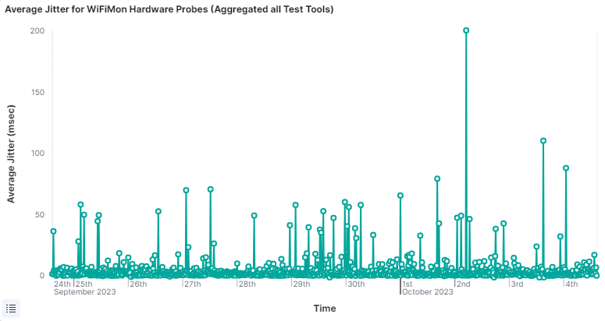
Average Jitter
Average Jitter during the last 10 days:
Increased jitter (blue circle) is reported on October 2nd

Slide 13
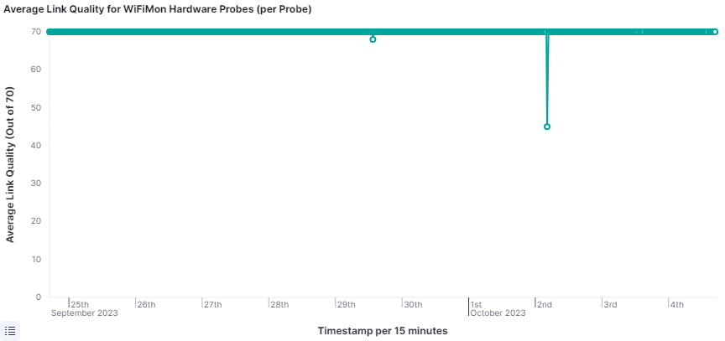
Average Link Quality
Average link quality reported from the probe wireless NIC:
Link quality (WLAN NIC) does not capture the performance drops reported by the active monitoring tools (Boomerang and LibreSpeed)
A major drop on October 2nd matches the jitter increase (previous slide)

Slide 14
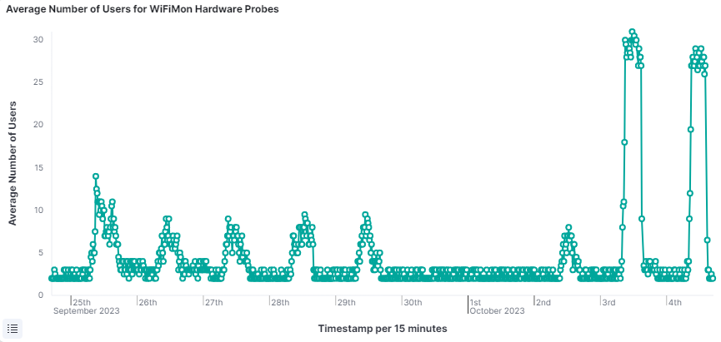
Average Number of Users
Average number of Wi-Fi users reported by the arp-scan Linux utility:
Almost no users during the weekend (blue rectangle)
Higher number of users on October 3rd and 4th (green rectangle) when a conference took place at IIAP

Slide 15
Installation

Slide 16
WiFiMon Installation
Ansible playbook for WAS/WTS automated installation
Duration: 15 - 20 minutes

Slide 17
WHP Configuration & Control

Slide 18
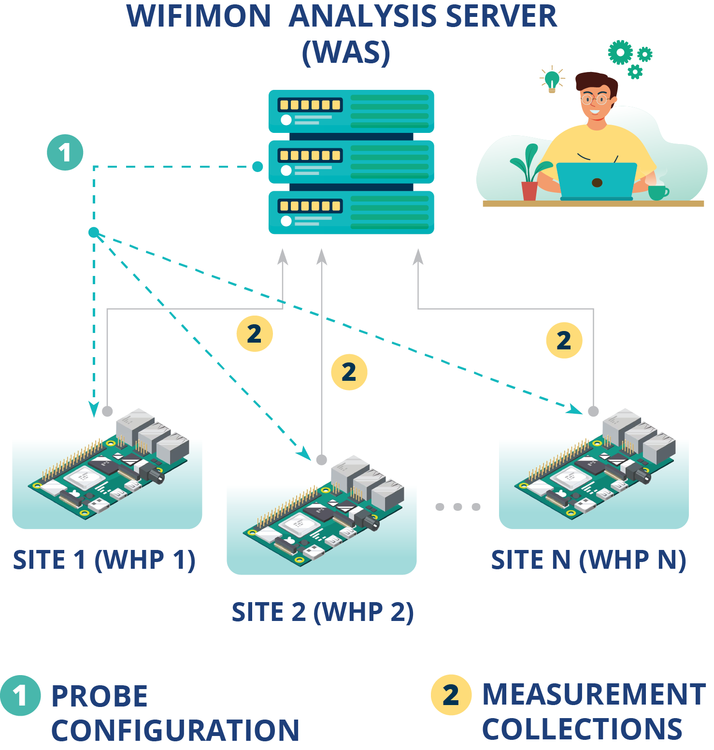
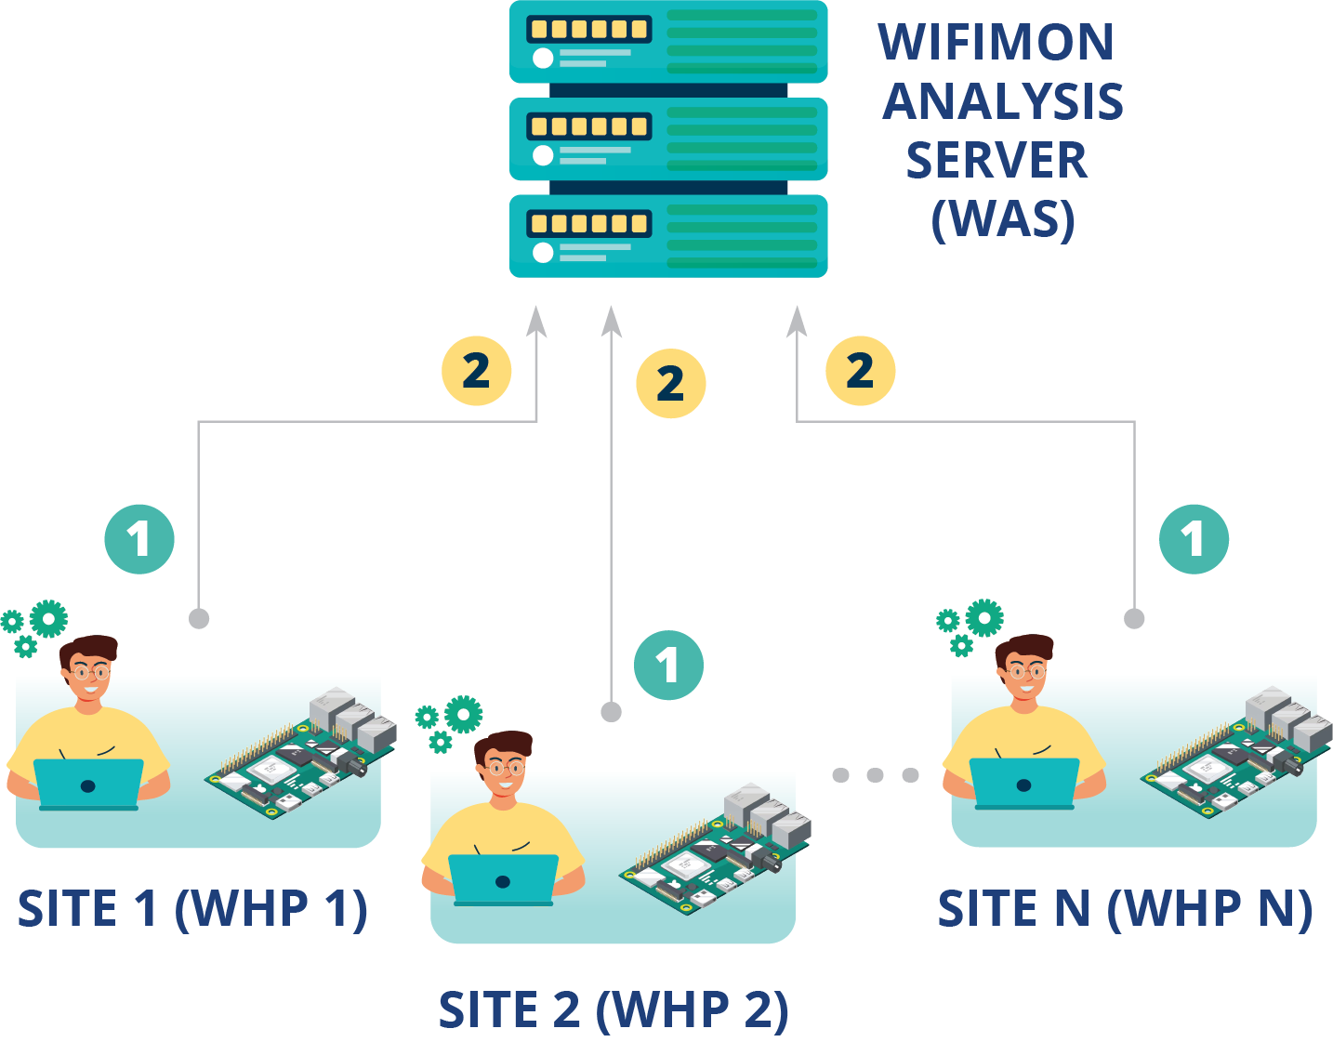
WHP Configuration & Control
Old approach
Limitations reported by WiFiMon users:
WHP configuration proved time-consuming (especially for NAT networks)
Manually editing configuration files proved hard and error-prone
Novel approach introduced!
Remote & user-friendly configuration of WHPs from a central point (WAS)
Flexibility to control WHPs behind NAT networks

Slide 19
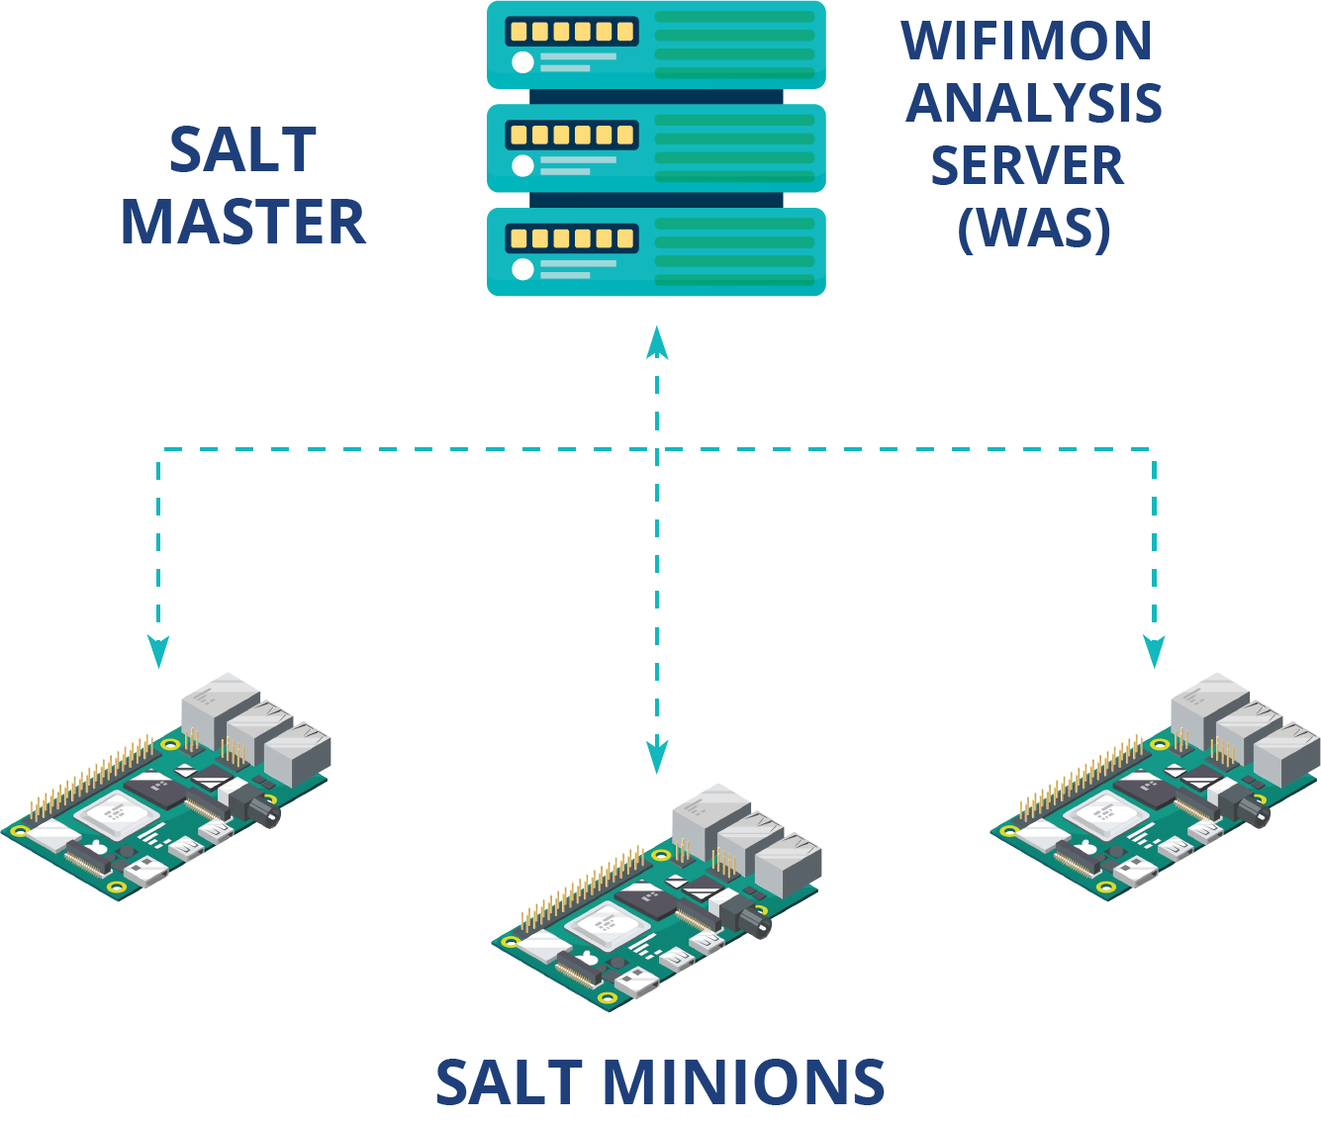
Remote WHP Configuration Made Possible
1
Salt establishes application layer communication: - WHPs remotely configured from the WAS
Reconfiguration easier for WHPs behind NAT
Public IP addresses not required
→ IP space is conserved
Based on Salt
WAS→ Salt Master
WHPs→ Salt Minions
2
Salt includes a ZeroMQ message broker: Parallel configuration regardless of the WHP number
3
Configuration files generated from Jinja2 templates transferred from the WAS to WHPs

Slide 20
Basic Steps Towards Anomaly Detection

Slide 21
WiFiMon Anomaly Detection Feature
Older WiFiMon versions:
WiFiMon administrators are expected to manually inspect measurements
No mechanisms to automatically detect important throughput deviations
WiFiMon v2.2.0 (current version) introduces mechanisms for automated time series analysis
Anomalies are detected using the Hampel method, which assesses deviations from a median value evaluated for specific time windows
WiFiMon UI has been enriched to support the new feature
Still under improvement

Slide 22
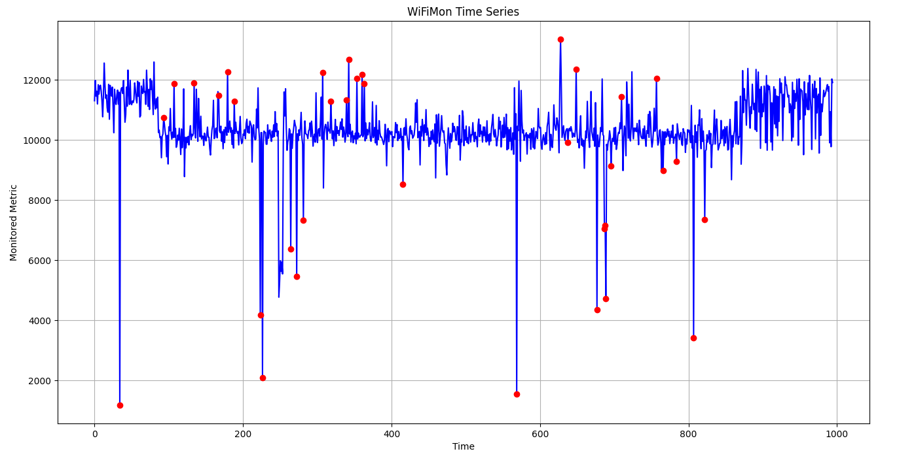
Results for ASNET-AM Pilot (1/2)
Red dots indicate points that should be further inspected

Slide 23
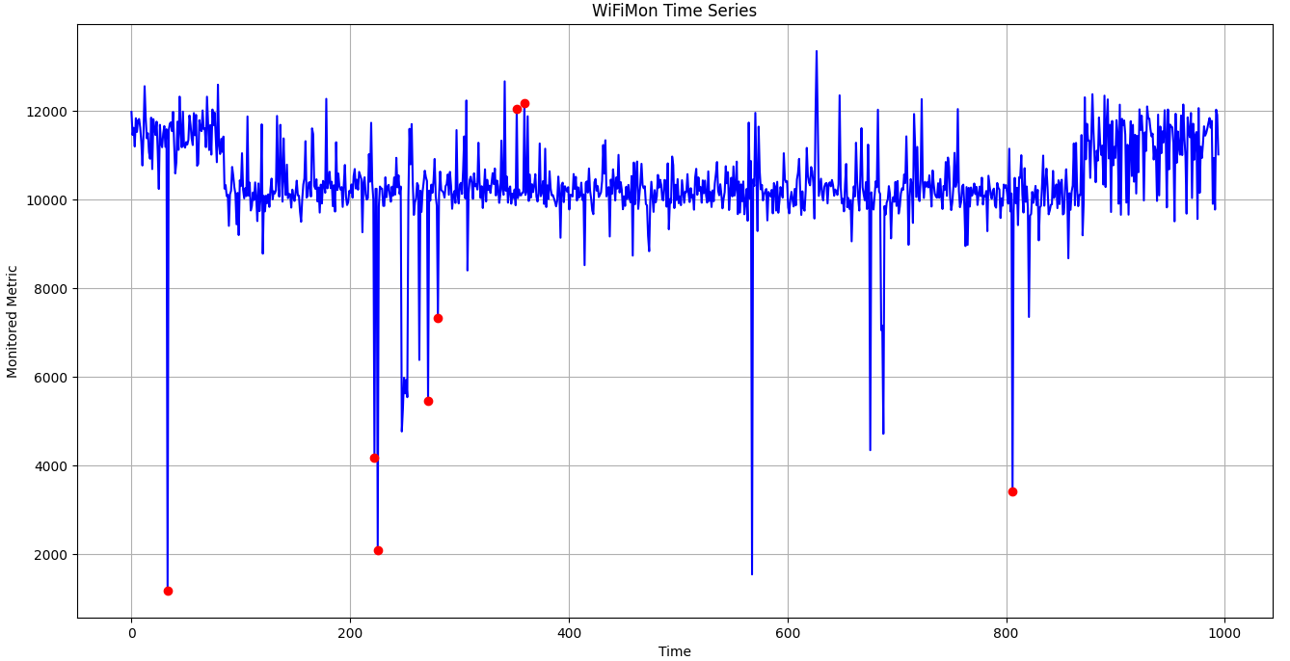
Results for ASNET-AM Pilot (2/2)
Stricter Hampel method parameters may return less red dots, i.e. anomaly indications that are more serious

Slide 24
Thank You

